Slide 1
Photomicrographs of Plant Seeds
Blackberry
Permission to reproduce original photomicrographs used to make this collection may be obtained from
Dr. David O. Norris at
david.norris@colorado.edu

Slide 2
10X
25X
Blackberry seed
Notes:
S3. Blackberry (Rubus plicatus cultivars.) seed

Slide 3
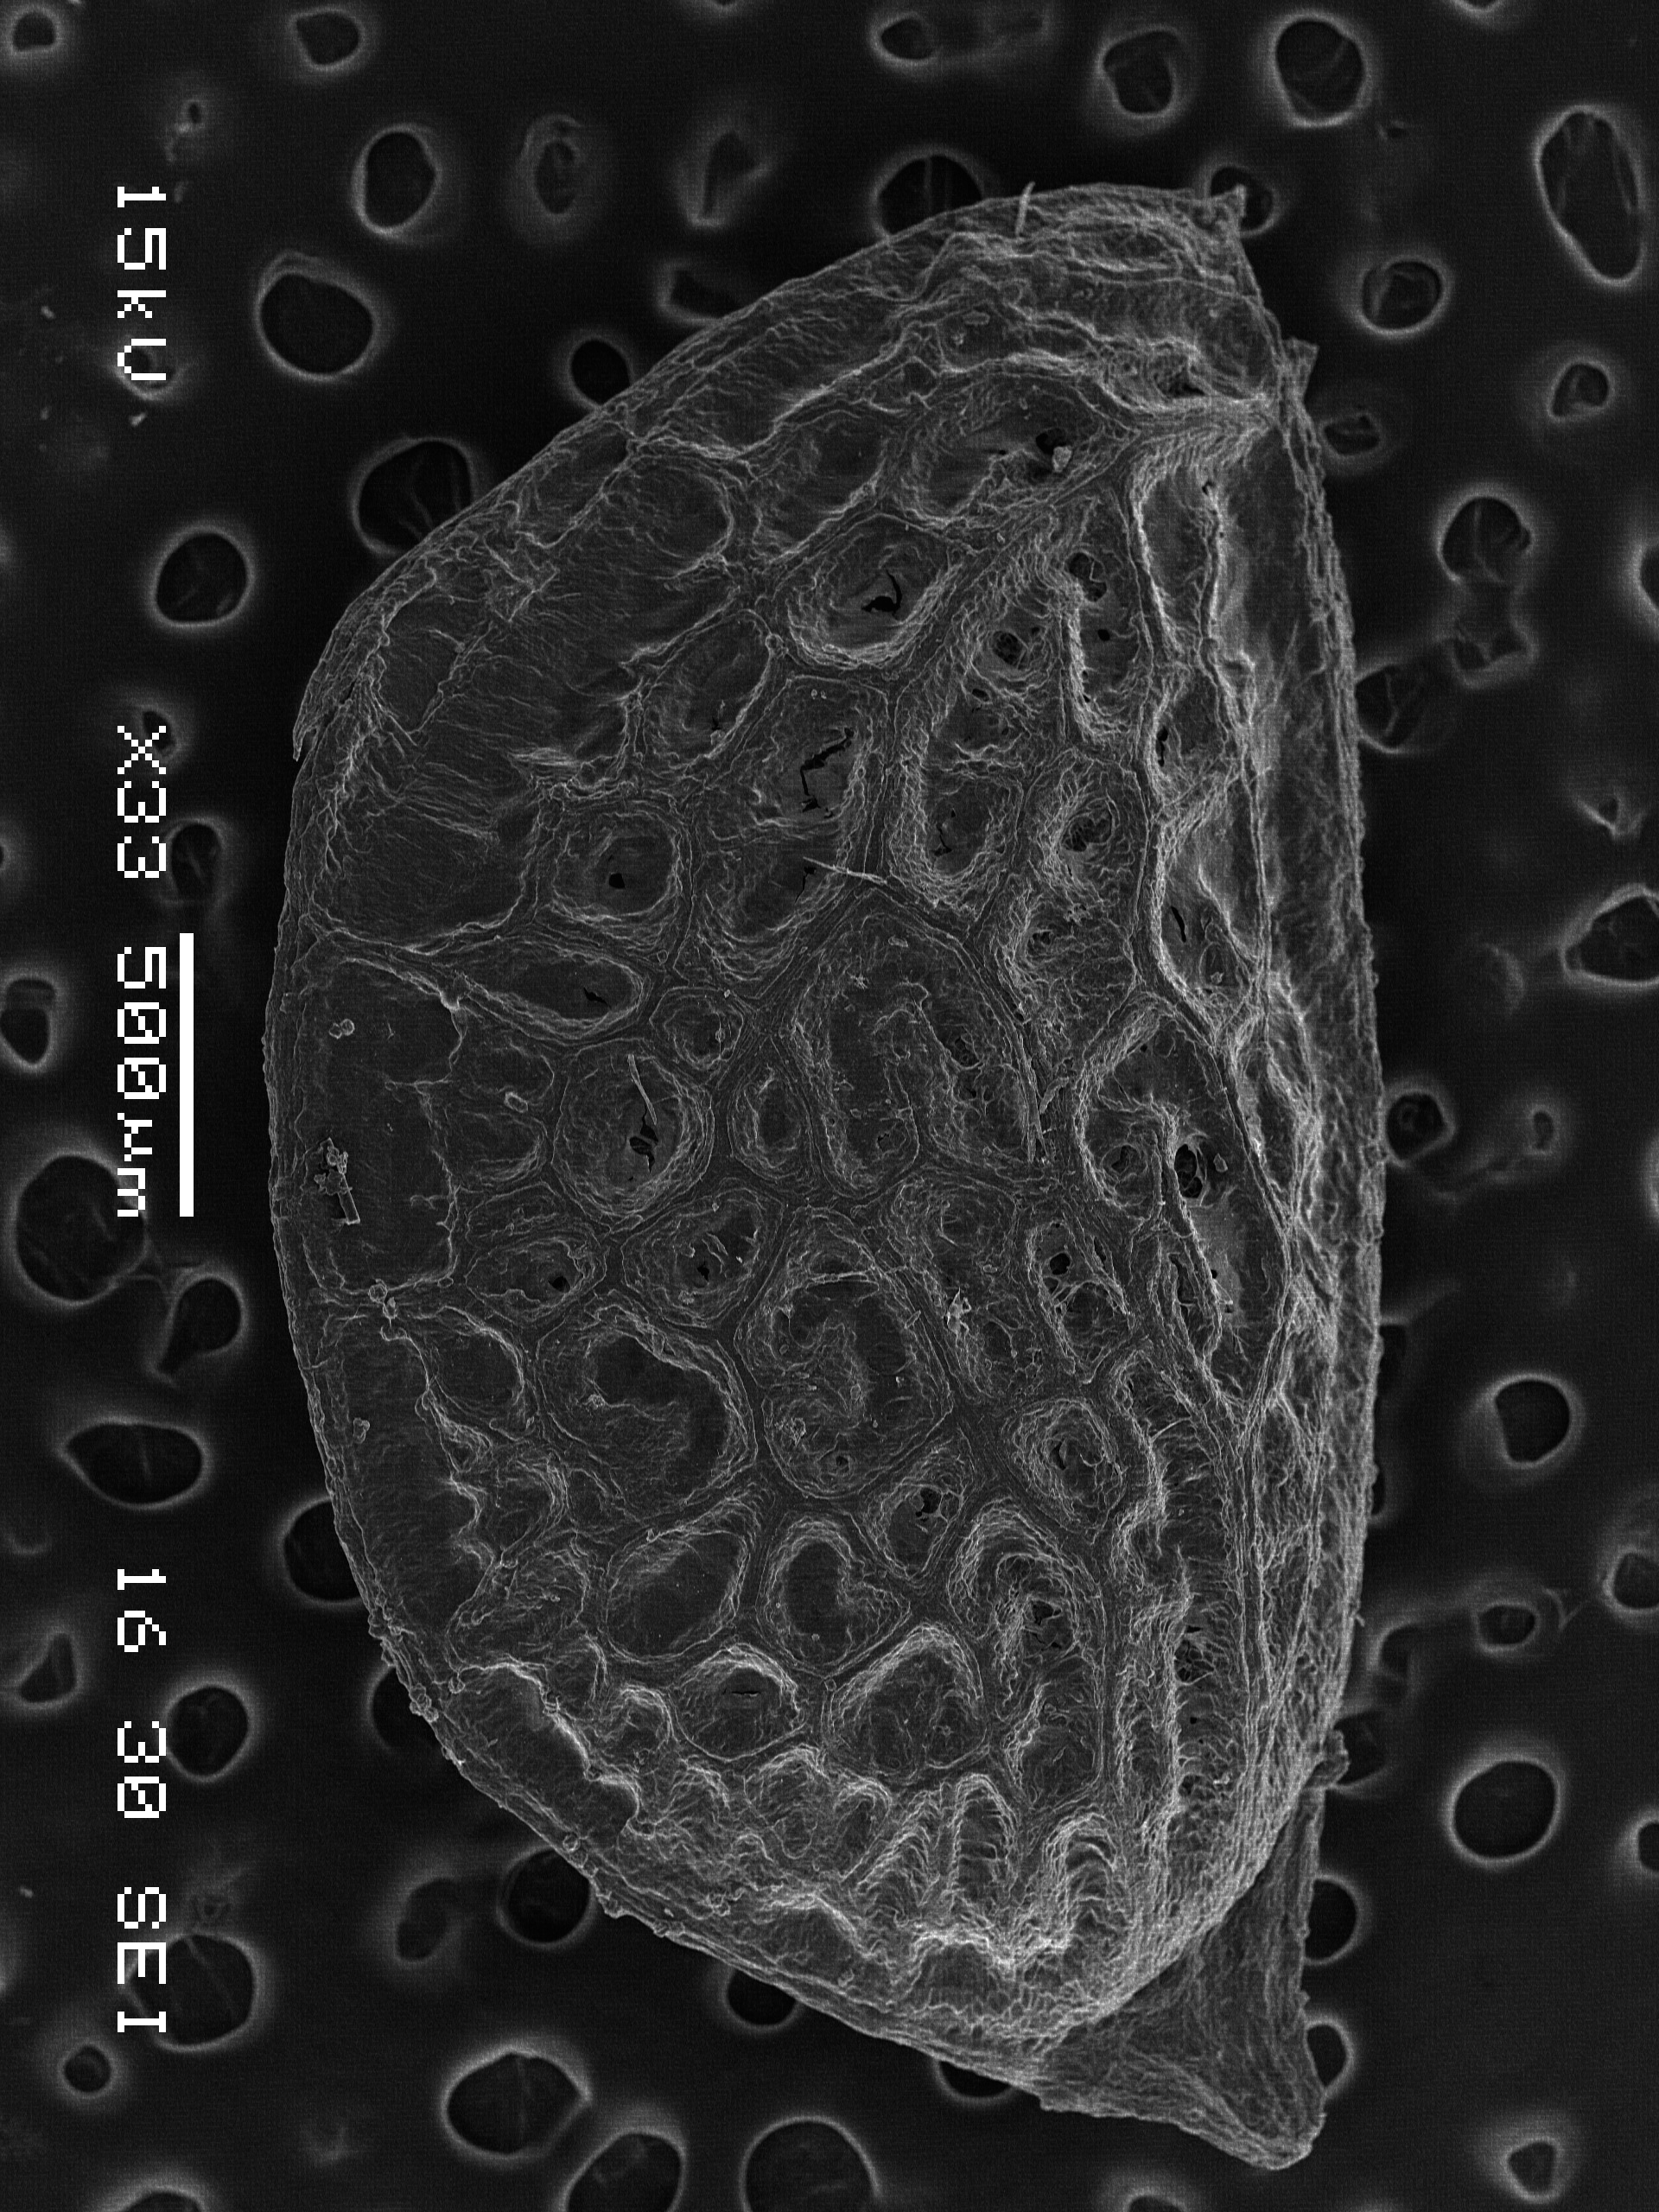
A
B
Blackberry
Seed
Notes:
S4. Blackberry seed. SEM A. Seed. B. Seed coat texture. SEMs prepared by Dr. Patrick Kociolek and Joshua Stepanek.

